Slide 1




Unified Observability for Wholesale Credit and Lending
Cross-platform logging, tracing, and incident automationTarget-state architecture across DCP, GCP, and legacy with correlation ID-driven traceability and SRE-ready dashboards

Slide 2







Unified Observability Target-State
Consistent tracing and incident workflows across PowerApps, Azure, GCP, and legacy
Unified telemetry across PowerApps, Azure, GCP, and legacy platforms
Single observability layer for consolidated troubleshooting
End-to-end traceability using Correlation ID from UI to backend
Full request context for faster root cause analysis
Summary: unified observability enabling consistent KPIs and accelerated incident lifecycle
OpenTelemetry ingestion with Grafana, Loki, and Tempo as the stack
Standardized telemetry pipeline and storage
Faster detection and response via xMatters and ServiceNow integration
Automated alerts and ticketed incident workflows
Operational clarity for engineering and product teams
Foundation for SRE practices, SLOs, and regulatory-grade audit trails
Enables runbooks, SLAs, and compliant auditing
Why it matters: consolidated troubleshooting, consistent KPIs, faster RCA and release decisions
Clear SLAs for Product and Delivery; operational model for SREs

Slide 3




Unified Observability Target-State Architecture
PowerApps, Azure, OTEL, Grafana, GCP, AppDynamics, xMatters, ServiceNow
01
PowerApps event capture
Front-end instrumentation and correlation ID injection at source.
02
Application Insights
Central telemetry ingest and short term retention; initial normalization.

Slide 4



03
Azure Storage
Durable raw telemetry archive for transformation and replay.
04
Azure Functions
Transform, enrich, and forward normalized telemetry to OTEL Collector.

Slide 5
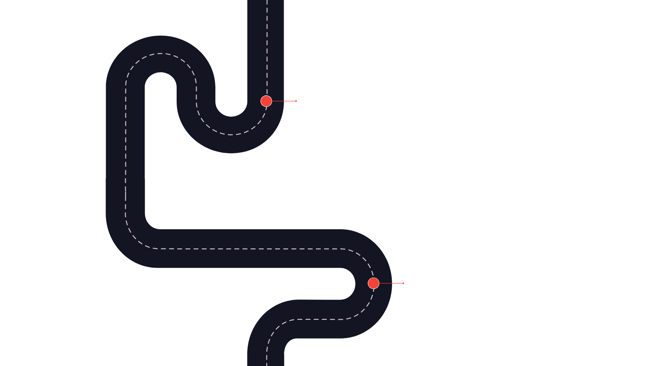


Unified Observability Target-State Architecture
PowerApps, Azure, OTEL, Grafana, GCP, AppDynamics, xMatters, ServiceNow
05
OpenTelemetry Collector
Cloud-agnostic collector: normalization, enrichment, sampling, and correlation preservation.
06
Loki, Tempo, Prometheus
Logs to Loki, traces to Tempo, metrics to Prometheus for storage and query.

Slide 6
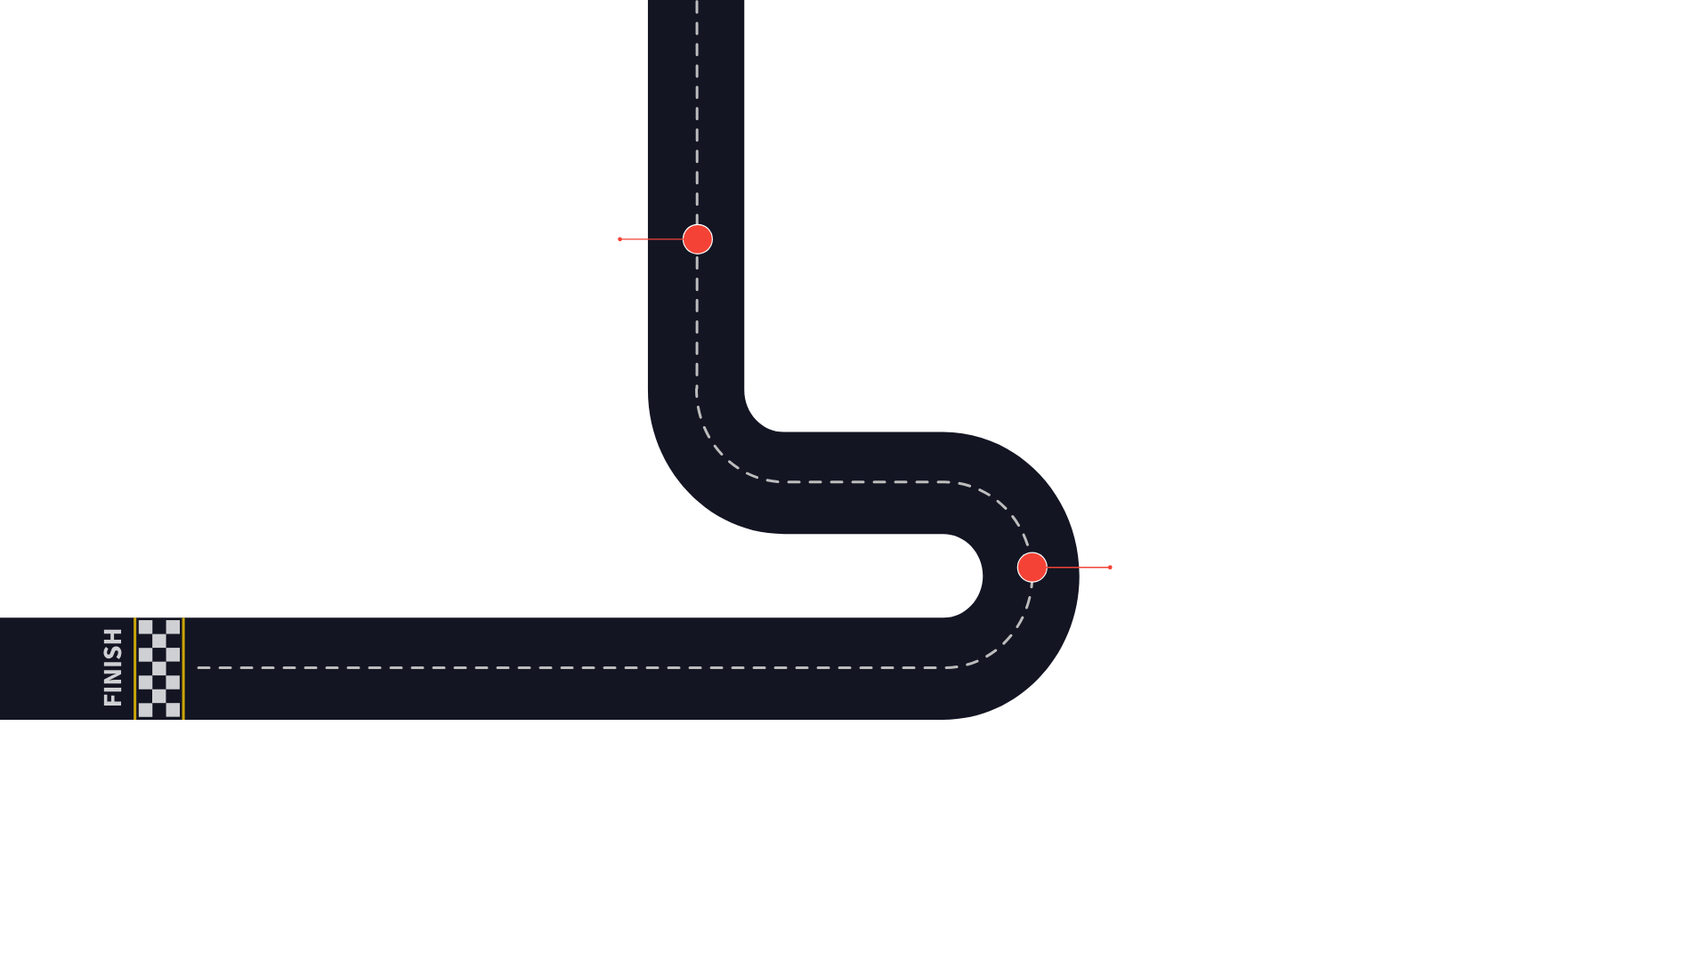


Unified Observability Target-State Architecture
07
PowerApps, Azure, OTEL, Grafana, GCP, AppDynamics, xMatters, ServiceNow
Grafana visualization
Central dashboards, combined visual traces, metrics, and logs; alerting source.
08
Incident routing
Alerts from Grafana and OTEL plus GCP Monitoring to xMatters then ServiceNow.

Slide 7
Correlation ID Strategy
Single ID from PowerApps to backend for end-to-end traceability
Generate at PowerApps
Use Loki for logs and Tempo for traces to visualize end-to-end flows
Create a single correlation_id at the PowerApps entry point; use consistent field name
Validation and testing
Propagate through custom connectors
Add automated tests to confirm header names and propagation at key checkpoints
Include correlation_id in HTTP headers and connector metadata for downstream services
Privacy and compliance
Pass via API gateway
Do not include PII in correlation_id or its metadata
Preserve correlation_id as request header and gateway log field for routing and debugging
Annotate backend microservices logs
Log correlation_id in each service (field name correlation_id) to stitch traces
Observe in Grafana stack

Slide 8
PowerApps Logging and Telemetry Flow
Normalize telemetry from PowerApps to OTEL for unified observability
PowerApps Emit Telemetry
Normalize JSON to schema; add metadata: service, region, app name
Usage, errors, performance with Correlation ID included
Convert to OTLP
Azure Application Insights
Transform normalized data to OTLP format for OTEL Collector
Logs and custom events collected for tracing and diagnostics
OTEL Collector
Diagnostic Settings to Storage
Receives OTLP for routing to Grafana, AppDynamics, GCP, xMatters, ServiceNow
Continuous export routes logs to an Azure Storage Account
Azure Function Trigger
Function activates on new blob files; must handle retries and idempotency
Normalize and Enrich

Slide 9
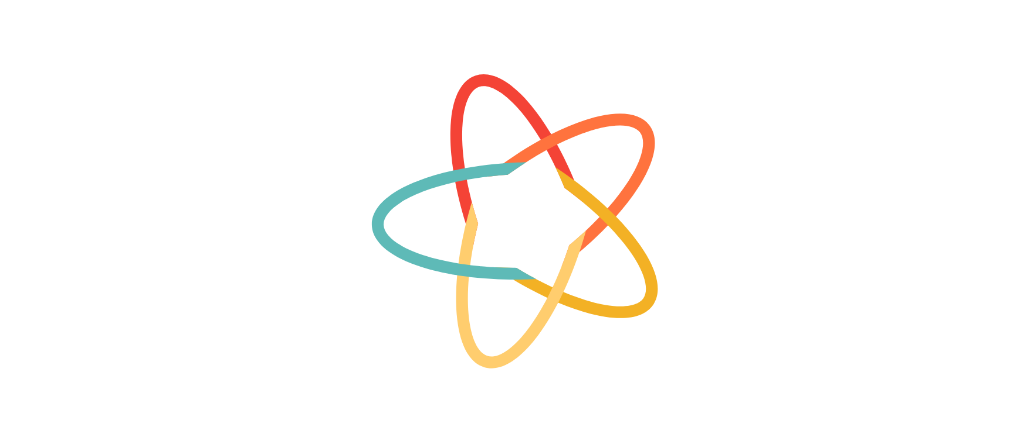
OTEL Collector Architecture
Cloud-agnostic ingestion for logs, traces, and metrics
Deployment Options
Self-hosted Collector on AKS or VM with HA and autoscaling
Receivers
OTLP from Azure Functions and backend services; Prometheus receiver for service and infra metrics
Operational Controls
Separate collectors for high volume or tenant isolation; monitor health and backpressure
Processors
Batching, attribute enrichment, and sampling; define pipelines per environment
Exporters
Logs to Loki, traces to Tempo, metrics to Prometheus and Grafana

Slide 10







Central Observability with Grafana Stack
Unified logs, metrics, and traces for fast RCA
01
Grafana: single-pane-of-glass dashboards
02
Loki: structured log store with labels
03
Tempo: distributed tracing and transaction path
04
Benefits: E2E flow visualization and correlated RCA
Combine logs, metrics, and traces for one view
Label queries by environment, app, correlation_id
Show full service call path for end-to-end traces
Correlate logs and traces to accelerate root cause
05
Design: role-specific dashboards with drilldowns
06
Ops: templated dashboards and shared folders
07
Mock layout: KPI, Top errors, Correlation-id drilldown
SRE, Product, Support views with KPI to correlation_id
Maintain consistency across teams and environments
KPI tiles -> error table -> log/trace linked by id

Slide 11

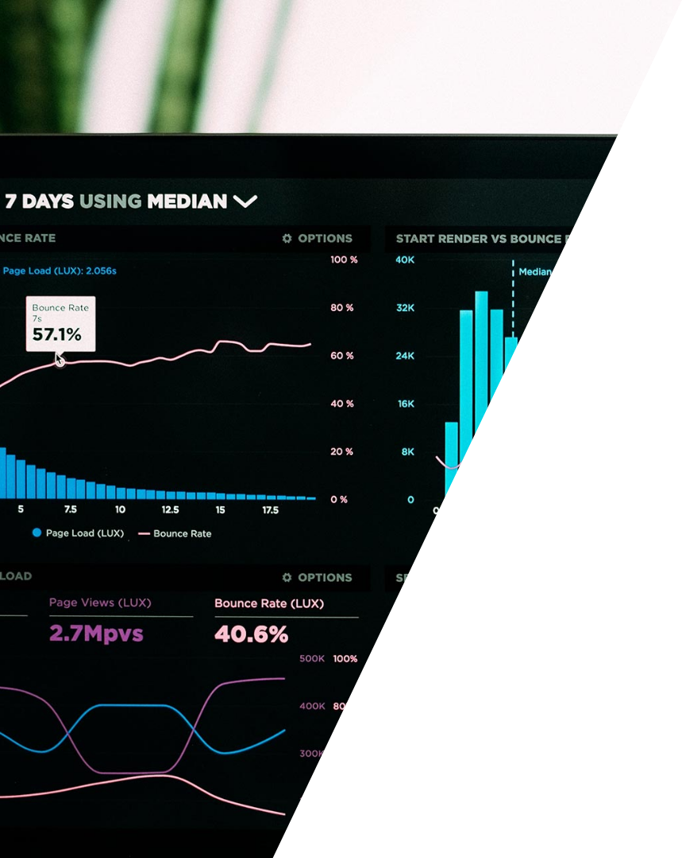




Unified Dashboards for Credit and Lending Journeys
Combine business KPIs with technical signals for fast cross-functional triage
Business journey
Application and environment
Drilldown and actions
Map dashboards to journeys: credit application, loan booking
Drill by Correlation ID into logs and traces
App/microservice view: error rate, latency, throughput
Navigation links to runbooks and RCA templates
Key widgets: STP% for each journey, Top failing flows
Environment filters: dev, UAT, prod
Top failing APIs list and quick remediation links
KPI pairing: business metric with error rate and latency
Separate legacy, Azure, GCP, PowerApps perspectives

Slide 12
Incident Automation: xMatters and ServiceNow
Alerts from observability to on-call plus automated incident capture
01
02
03
04
05
Monitoring Sources
xMatters Notification
On-call Engineer
ServiceNow Incident
RCA and Closure
Error rate spikes, latency SLO breaches, PowerApps failures, backend and API failures from OTEL, Grafana, and GCP Monitoring
xMatters receives alerts and sends push, email, or SMS based on rota
On-call engineer triages alerts and follows escalation policies and playbooks
ServiceNow auto-creates incident containing correlation ID, dashboard link, and environment
Use ServiceNow for RCA documentation, incident closure, and audit metadata

Slide 13
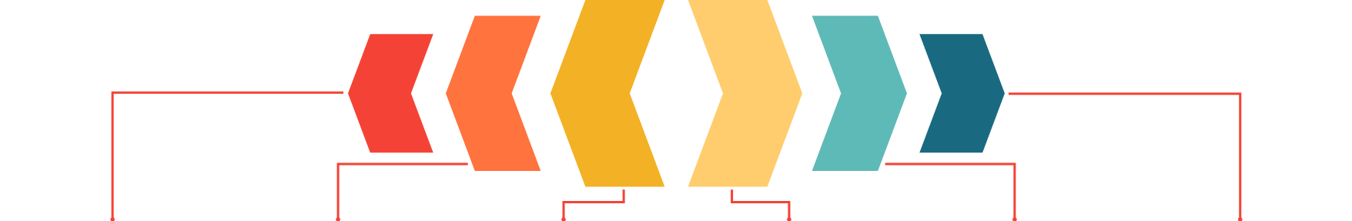
Unified Observability Target-State
GCP logging and monitoring pipeline for consistent alerts and retention
GCP Sources
Log Routing
Streaming Collector
Storage and Query
Alerting and Ops
Governance and Ownership
GKE, Cloud Run, Compute Engine emit logs to Cloud Logging and metrics to Cloud Monitoring.
Log Router selects and forwards logs to Pub/Sub for off-cluster processing and retention control.
GCP Monitoring alert policies route critical signals to xMatters and ServiceNow for incident handling.
Pub/Sub to OTEL Collector for processing, sampling, and sensitive-data filtering before storage.
Loki stores logs; Prometheus or Managed Prometheus stores metrics scraped from GKE and forwarded by OTEL.
Define log routing to avoid duplication, control trace sampling, enforce IAM and routing rules, and align alerts with SLOs.

Slide 14
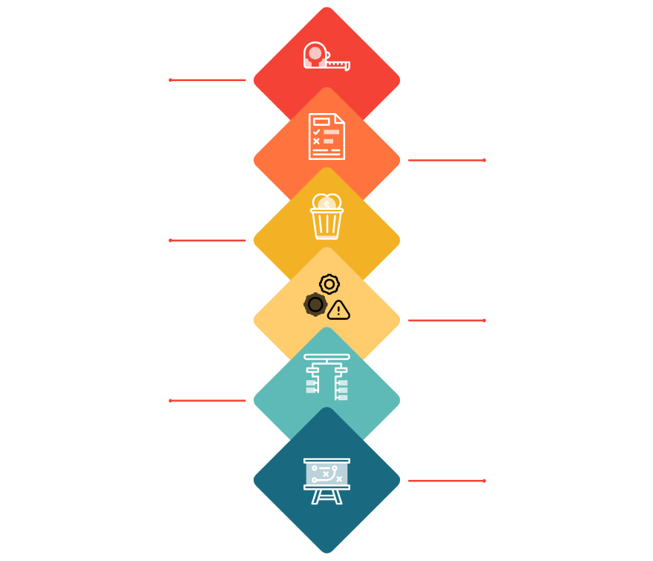
GCP Alerting and SLO Framework
SLO-driven monitoring for APIs, infrastructure, and incidents
SLI Measurement
Measure availability, latency, and error rate for APIs using Cloud Monitoring SLIs.
SLO Evaluation
Compare SLIs to SLO targets to determine compliance and remaining error budget.
Error Budget
Track error budget consumption to balance reliability and feature velocity.
Alerts
Trigger SLO burn rate alerts and infrastructure alerts for node and pod health.
Incident Flow
Cloud Monitoring alert to xMatters to ServiceNow incident for coordinated response.
Operational Guidance
Start with critical SLOs aligned to customer journeys and tune thresholds to avoid alert fatigue.

Slide 15





Legacy Monitoring with AppDynamics
Keep deep diagnostics for monoliths while unifying signals to OTEL
Export BT metrics/events to central OTEL pipeline
Selective signal export for consolidated dashboards
Keep AppD agents active for JVM and .NET diagnostics
Retain snapshots and deep traces for legacy faults
Business Transaction view, response time and error snapshots
Primary tool for legacy core banking and monolithic apps
Hybrid strategy: export key metrics and events to OTEL
Operational controls: maintain runbooks and clarify ownership
Balance: keep AppD for deep troubleshooting and OTEL for centralization
01
02
03
04
05
Update runbooks and incident ownership across boundaries
Clear roles when incidents span legacy and cloud
Monitor integration health between AppD and OTEL path
BT-centric visibility plus JVM and .NET deep diagnostics
Used where re-instrumentation is risky or infeasible
Consolidate visibility while retaining AppD diagnostics
Define incident paths when issues cross legacy and cloud
Preserve diagnostic depth and enterprise visibility
Validate fidelity and latency of exported signals
Summary: retain AppD for depth, OTEL for consolidation
Hybrid approach delivers both diagnostics and unified view

Slide 16
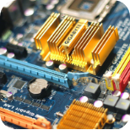
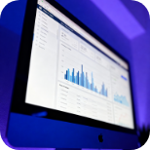





Integrating AppDynamics into OTEL View
Side-by-side native AppDynamics and OTEL-consolidated perspectives
AppDynamics native view
OTEL-consolidated view
Rich BT and node instrumentation: Business Transaction response time, CPU, errors
Unified metrics model in OTEL: span metrics, resource attributes, logs
Vs
Proprietary KPIs and UI optimized for AppD workflows
Example mapping: Business Transaction response time to OTEL span metric named span.duration.ms with service and BT labels
APIs available for metric and event export
Immediate real-time dashboards and deep diagnostic traces
Integration approaches: AppD API exporter, custom OTEL exporter, periodic batch export or synthetic transactions
Validation phase: inventory metrics, map units and labels, parity checks in Grafana dashboards

Slide 17












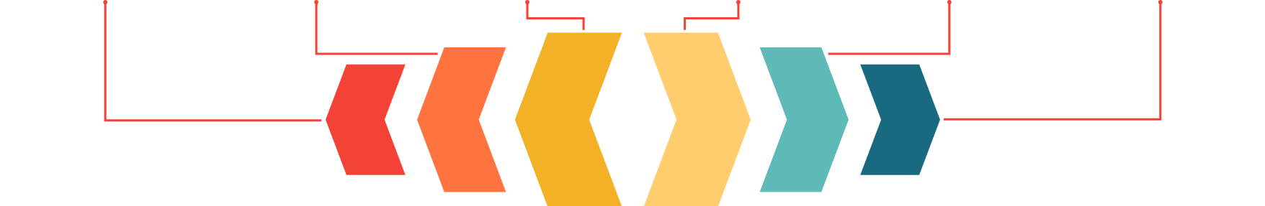
End-to-End Observability Map
PowerApps, Azure, GCP, AppDynamics → OTEL to Grafana
Domain Sources
Collection Layer
Storage and Observability
Taxonomy and KPIs
Cross-Platform Correlation
Operational Integrations
PowerApps front-end, DCP Azure services, GCP microservices, legacy on-prem with AppDynamics emitting telemetry.
OTEL Collector standardizes traces, metrics, and logs from all domains.
Grafana with Loki for logs and Tempo for traces centralizes analysis and dashboards.
Common tagging and labeling conventions with consistent KPI definitions across platforms.
Link traces, logs, and metrics across PowerApps, Azure, GCP, and AppDynamics for a single observability story.
Alerting and ticketing integrations with xMatters and ServiceNow for incident response.

Slide 18
























Governance, Standards and Compliance
Standard log schema, retention, masking and access controls
Schema field
Purpose
Example
Privacy handling
Retention tiers
Hot logs 30–90 days; warm/cold moved to archive per regulation
timestamp
Event ordering and correlation
2025-06-01T12:34:56Z
Low risk — no PII
Masking at ingestion
level
Severity classification
ERROR
Low risk
Apply masking or tokenization to prevent PII storage
service
Service or component source
payments-api
Low risk
Role based access control
RBAC for dashboards and raw logs with least privilege
correlation_id
Trace across services
abc123-trace
Tokenized if links to user
Periodic access reviews
error_code
Operational diagnostics
PAYMENT_402
Low risk
Regular reviews and audit logging for compliance
region
Data residency and routing
us-east-1
Handled per regional policy
Auditor evidence
Provide traceable pipelines and incident records on request
environment
Runtime context
prod
Restricted for debug data

Slide 19
SRE KPIs and SLOs for Credit and Lending Apps
Core reliability measures and actionable adoption guidance
Availability: % uptime for core lending APIs
Track service availability for customer-facing endpoints
Latency: P95 and P99 (example P95 under 200 ms)
Measure tail latency for credit decision and API calls
Error rate: 5xx and failed transaction counts
Monitor API and transaction failures impacting customers
STP percent: Straight Through Processing for critical flows
Percent of flows completing without manual intervention
SLO examples: 99.9% availability; P95 latency under 200 ms
Concrete targets for core lending APIs and decision endpoint
Ownership: assign an owner per SLO and measure SLIs in production
Clear accountability and production-grade measurement
Error budget policy: throttle risky changes and gate releases
Use error budgets to balance reliability and feature delivery
Operations: incorporate SLOs into release gating and incidents
Use SLOs for prioritization and post-incident refinement

Slide 20


0–3 months
Standards and initial platform setup
Finalize logging schema and correlation ID; implement PowerApps to App Insights to OTEL pattern; stand up OTEL Collector and initial Grafana dashboards
3–6 months
Service onboarding and incident pipeline
Implementation Roadmap: Unified Observability
Onboard key Azure and GCP services; integrate xMatters and ServiceNow pipeline; roll out first SLOs and error budgets
6–12 months
Legacy coverage and SRE maturity
Extend coverage to legacy via AppDynamics to OTEL bridge; mature RCA, runbooks, and SRE practices; introduce anomaly detection and ML where useful
6–12 month timeline for PowerApps, Azure, OTEL, Grafana, GCP, AppDynamics, xMatters, ServiceNow
Ongoing
Deployment controls and verification
Use pilots and phased rollouts; verify telemetry parity; maintain onboarding backlog; engage app teams early; schedule governance checkpoints

Slide 21

Closing: Unified Observability Target-State
Benefits, immediate next steps, and pilot call to action
Confirm scope and prioritization of app onboarding
Unified, cross-platform observability
Define which apps enter pilot and priority order
01
Single view across PowerApps, Azure, GCP, and legacy systems
Align stakeholders: App teams, SRE, Security, Compliance
Secure owners and decision makers for pilot
Faster incident detection and recovery
02
Improved MTTR with end-to-end traceability
Start pilot: one end-to-end lending flow (example)
Pilot kickoff to validate schema and SLOs
Stronger compliance and audit readiness
03
SRE and compliance controls for lending
Call to action: approve pilot, nominate owners, schedule kickoff workshop
Workshop to define schema, SLOs, and onboarding priority

